Slide 1
BIRCH (Balanced Iterative Reducing and Clustering using Hierarchies)
Notes:
A balanced tree is a type of data structure in which the height of the tree (the number of levels or depth) is kept as small as possible to ensure efficient operations, such as insertion, deletion, and lookup. In a balanced tree, the subtrees of any node have heights that differ by at most a certain amount, ensuring that the tree remains close to a minimum height for the number of nodes it contains.

Slide 2
Motivation
Major weakness of agglomerative clustering methods
Do not scale well; time complexity of at least O(n²), where n is total number of objects
Can never undo what was done previously
Birch: Balanced Iterative Reducing and Clustering using Hierarchies
Incrementally construct a CF (Clustering Feature) tree, a hierarchical data structure summarizing cluster info; finds a good clustering with a single scan
Apply multi-phase clustering; improves quality with a few additional scans

Slide 3
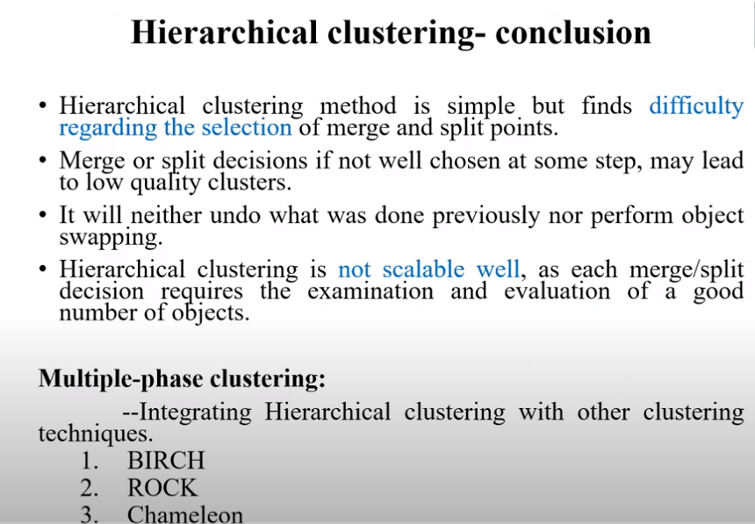

Slide 4


Slide 5
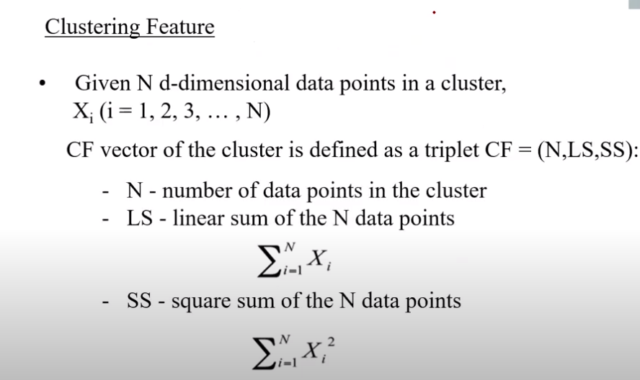

Slide 6
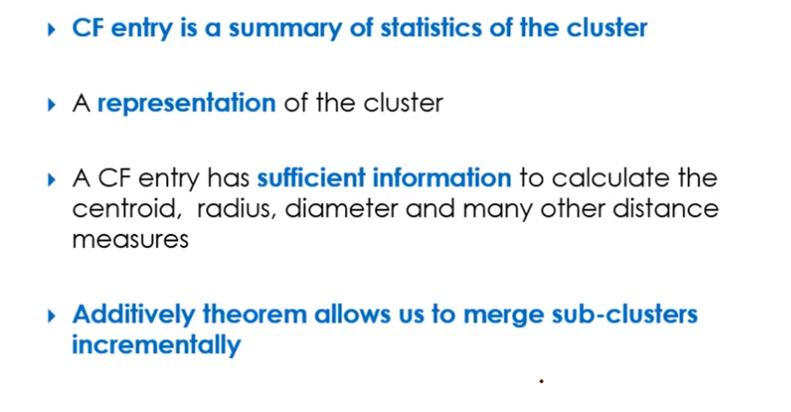

Slide 7
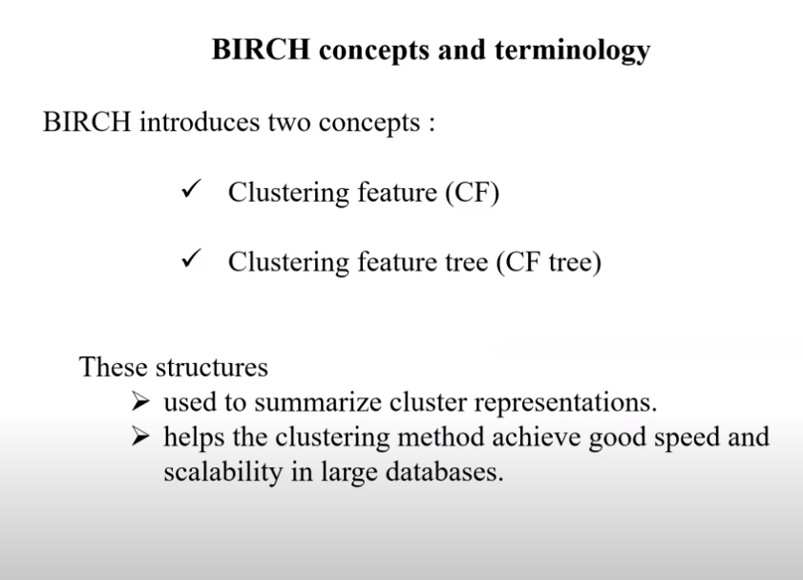

Slide 8
In the BIRCH (Balanced Iterative Reducing and Clustering using Hierarchies) algorithm, a Cluster Feature (CF) is a compact representation of a cluster of data points. Cluster Features are essential to BIRCH's ability to process large datasets efficiently, as they allow clusters to be summarized using minimal memory while retaining essential information for clustering.

Slide 9
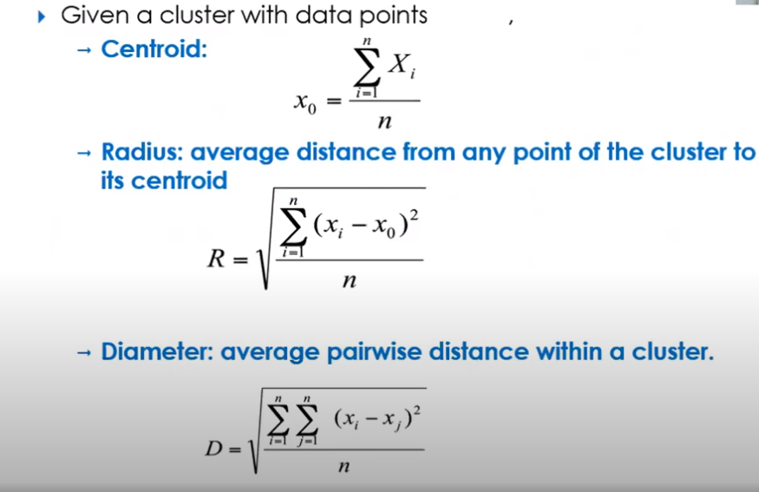

Slide 10
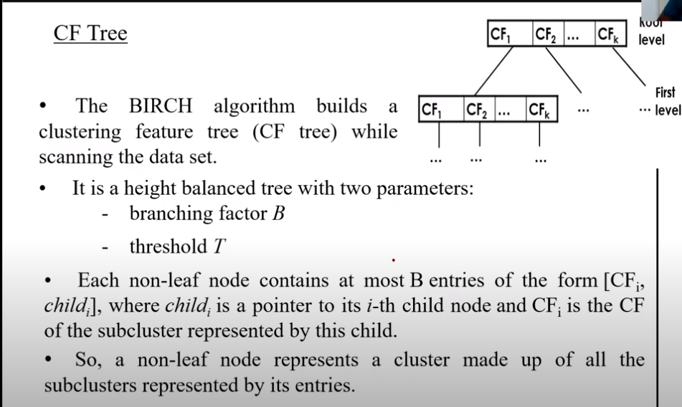
Root levels

Slide 11
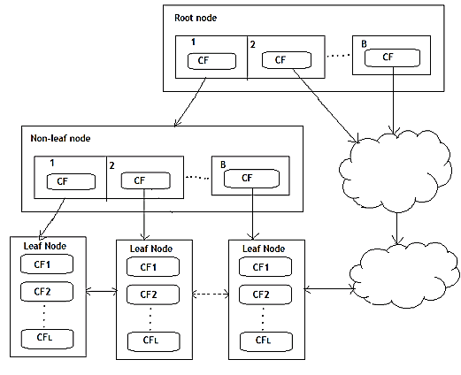
The branching factor is the maximum number of children a node can have.
Threshold T represents the diameter of the cluster
Structure of cluster
Notes:
Leag node we have sub clusters, at uppler levels we just have a structure of cluster
T is threshold follows by the sub claster

Slide 12
The branching factor is the maximum number of children a node can have.
Threshold T represents the diameter of the cluster

Slide 13
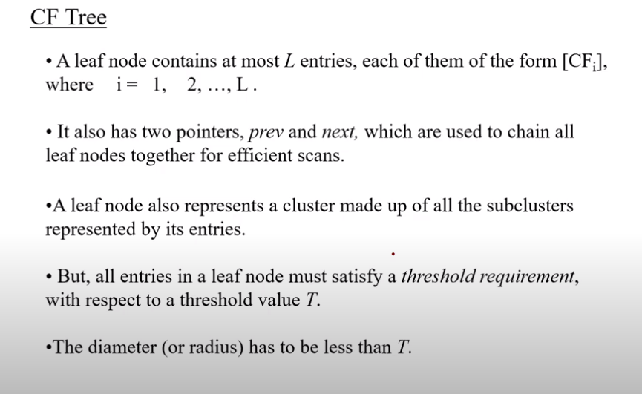

Slide 14
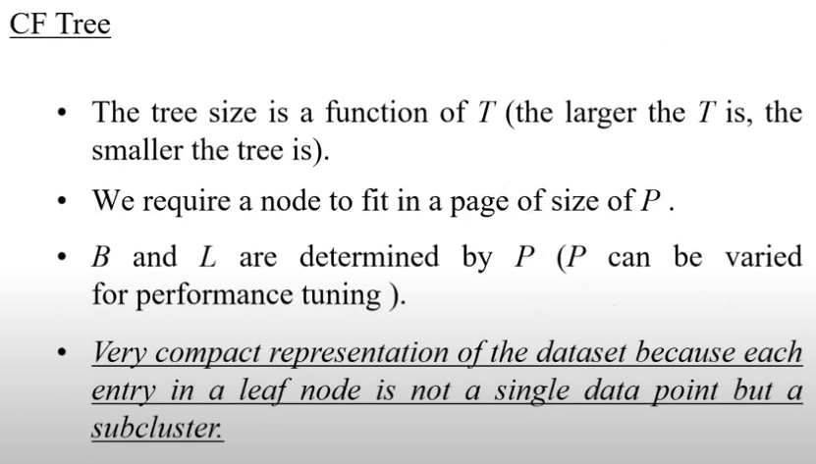

Slide 15
The branching factor is the maximum number of children a node can have.
Threshold T represents the diameter of the cluster
Structure of cluster
Notes:
Leag node we have sub clusters, at uppler levels we just have a structure of cluster
T is threshold follows by the sub claster

Slide 16
CF Additive Theorem
Suppose cluster C₁ has CF₁=(N₁, LS₁ ,SS₁), cluster C₂ has CF₂ =(N₂,LS₂,SS₂)
If we merge C₁ with C₂, the CF for the merged cluster C is
Why CF?
Summarized info for single cluster
Summarized info for two clusters
Additive theorem

Slide 17
Example of Clustering Feature Vector
Clustering Feature:
N: Number of data points
CF₁ = (5, (16, 30), (54, 190))
CF₂ = (5, (36, 17), (262, 61))
(3,4)
(2,6)
(4,5)
(4,7)
(3,8)
(6,2)
(7,2)
(7,4)
(8,4)
(8,5)
CF = (10, (52, 47), (316, 251))

Slide 18
Characteristics of BIRCH
It is a scalable clustering method.
Multiphase clustering
Designed for very large data sets
Only one scan of data is necessary
It overcomes the difficulty of agglomerative clustering where the decision to merge and split cannot be undone.
It is based on the notation of CF (Clustering Feature) and a CF Tree.
CF tree is a height balanced tree that stores the clustering features for a hierarchical clustering.
Cluster of data points is represented by a triple of numbers (N,LS,SS) Where
N= Number of items in the sub cluster
LS=Linear sum of the points
SS=sum of the squared of the points

Slide 19
BIRCH stands for Balanced Iterative Reducing and Clustering Using Hierarchies, which uses hierarchical methods to cluster and reduce data.
BIRCH only needs to scan the data set in a single pass to perform clustering.
How does it work?
The BIRCH algorithm uses a tree structure to create a cluster. It is generally called the Clustering Feature Tree (CF Tree). Each node of this tree is composed of several Clustering features (CF).
Clustering Feature tree structure is similar to the balanced B+ tree
Each node including leaf nodes has several CFs, and the CFs of internal nodes have pointers to child nodes, and all leaf nodes are linked by a doubly linked list.

Slide 20
T(threshold)

Slide 21
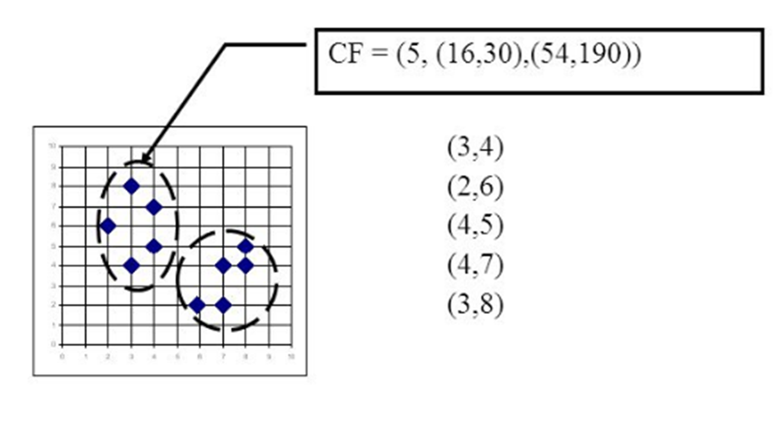
Clustering feature (CF) and Cluster Feature Tree (CF Tree)
In the clustering feature tree, a clustering feature (CF) is defined as follows:
Each CF is a triplet, which can be represented by (N, LS, SS).
Where N represents the number of sample points in the CF, which is easy to understand
LS represents the vector sum of the feature dimensions of the sample points in the CF
SS represents the square of the feature dimensions of the sample points in the CF.
For example, as shown in the following figure, in a CF of a node in the CF Tree, there are the following 5 samples (3,4), (2,6), (4,5), (4,7), ( 3,8). Then it corresponds to

Slide 22
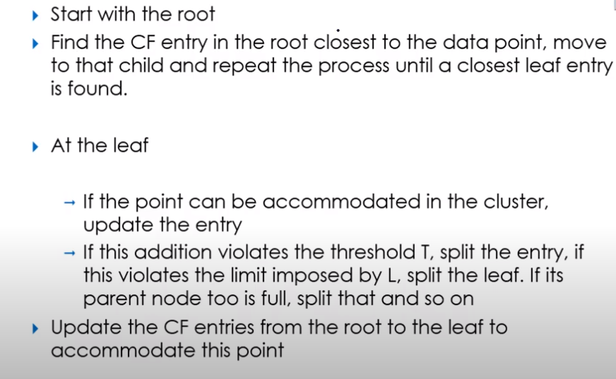
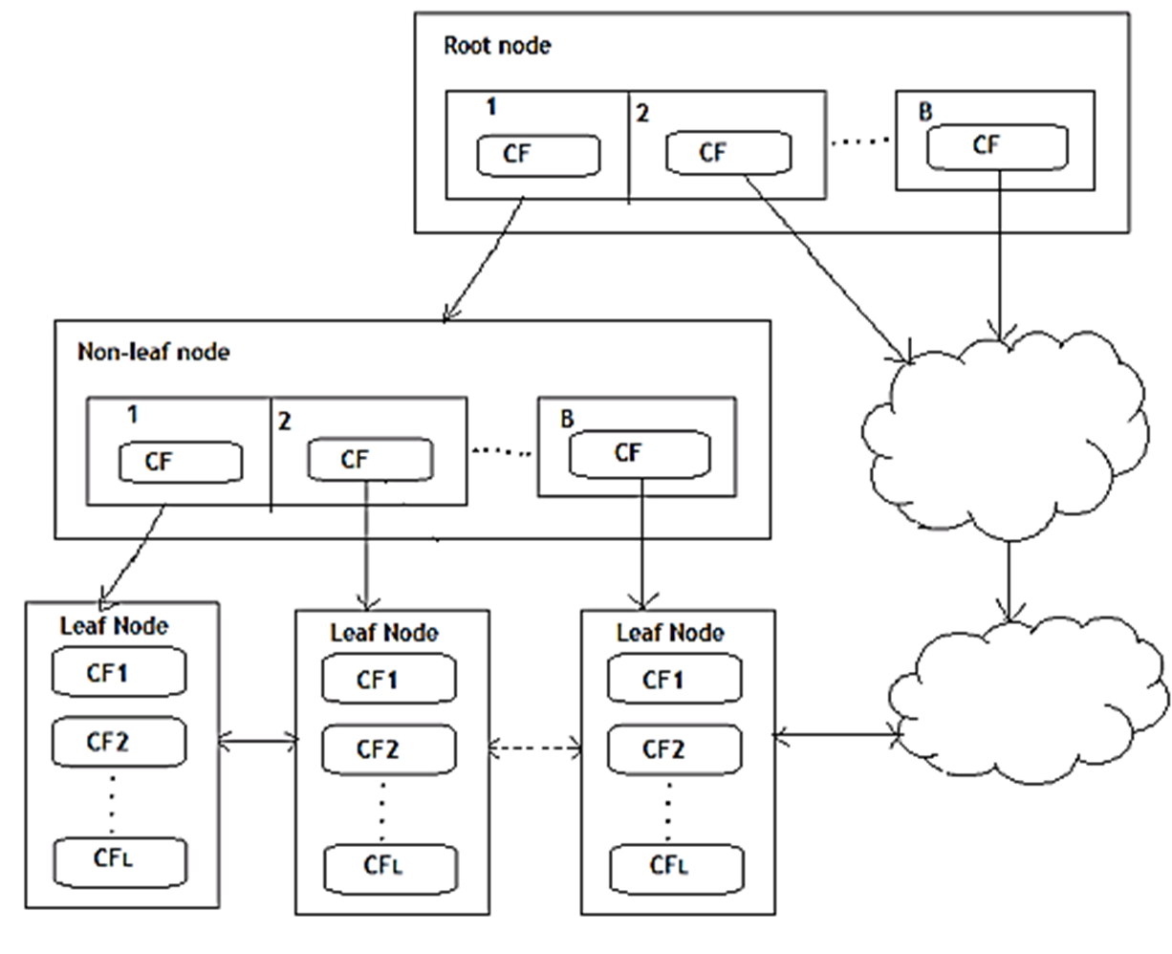
CF Insertion Tree

Slide 23
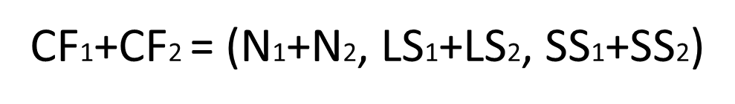
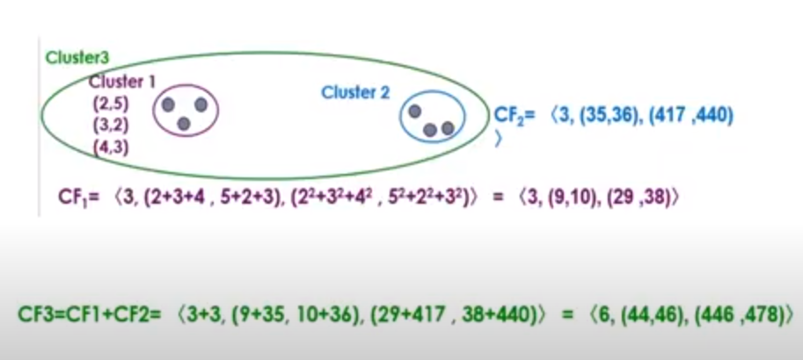
CF has a very good property. It satisfies the linear relationship, that is:

Slide 24
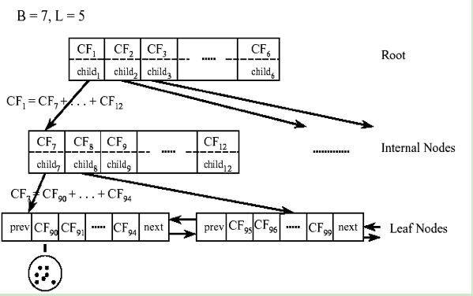
This property is also well understood by definition. If you put this property on the CF Tree, that is to say, in the CF Tree, for each CF node in the parent node, its (N, LS, SS) triplet value is equal to the CF node pointed to The sum of the triples of all child nodes.

Slide 25
Parameters of BIRCH
There are three parameters in this algorithm, which needs to be tuned. Unlike K-means, here the optimal number of clusters (k) need not be input by the user as they are determined by the algorithm.
✓ threshold : threshold is the maximum number of data points a sub-cluster in the leaf node of the CF tree can hold.
✓ branching_factor : This parameter specifies the maximum number of CF sub-clusters in each node (internal node).
✓ n_clusters : The number of clusters to be returned after the entire BIRCH algorithm is complete i.e., number of clusters after the final clustering step. If set to None, the final clustering step is not performed and intermediate clusters are returned.

Slide 26
Advantages and Disadvantages
Advantages:
Disadvantage: Handles only numerical data.
Cluster Shape: BIRCH is best suited for clusters that are spherical and evenly distributed in the feature space. It may not perform as well with clusters of arbitrary shapes.
Noise Sensitivity: BIRCH can be sensitive to outliers, especially in the initial clustering phase. Additional noise-handling techniques may be required.
Efficient with Large Datasets: BIRCH is one of the few clustering algorithms designed to handle very large datasets efficiently, making it ideal for big data applications.
Single Scan Capability: BIRCH can cluster data in a single scan, which is useful for applications that need quick, approximate clustering.
Incremental Clustering: BIRCH can adapt as new data arrives, making it ideal for applications requiring dynamic data clustering.

Slide 27
Applications of BIRCH
Customer Segmentation in Marketing:
BIRCH is often used to analyze large customer datasets, segmenting customers based on behavior, demographics, or purchasing patterns.
By dynamically clustering evolving customer data, it helps marketers target segments more accurately and efficiently.
Real-Time Data Analysis and Streaming Data:
In applications that require processing and analyzing streaming data, like IoT sensor data or log data, BIRCH’s incremental clustering is valuable.
It can continuously update clusters as new data arrives, which is particularly useful for monitoring network traffic, system logs, and social media feeds.
Image Segmentation and Compression:
BIRCH can be used to cluster pixels or regions in images based on color or intensity to facilitate image segmentation.
In image compression, it groups similar pixels together, reducing redundancy and aiding in efficient storage.
Text Mining and Document Clustering:
BIRCH is effective for clustering large sets of text data, such as organizing large document collections, emails, or social media posts.
By summarizing and clustering documents based on content similarity, it helps in information retrieval, topic extraction, and recommendation systems.
Anomaly Detection:
BIRCH can be applied to anomaly detection tasks by identifying clusters of normal behavior and treating outliers or less frequent clusters as anomalies.
This approach is valuable in fraud detection, network security, and identifying unusual patterns in financial transactions or healthcare data.
Recommendation Systems:
In e-commerce and streaming services, BIRCH can help cluster user preferences and item features efficiently, even with large and continually updated data.
These clusters can then be used to make recommendations, helping users discover content or products that align with their interests.
Genomics and Bioinformatics:
BIRCH is used for clustering large-scale genomic data, such as gene expression profiles or protein sequence data, where the number of clusters is unknown.
This clustering helps researchers understand genetic similarities and differences across large biological datasets, aiding in classification and pattern recognition.

Slide 28
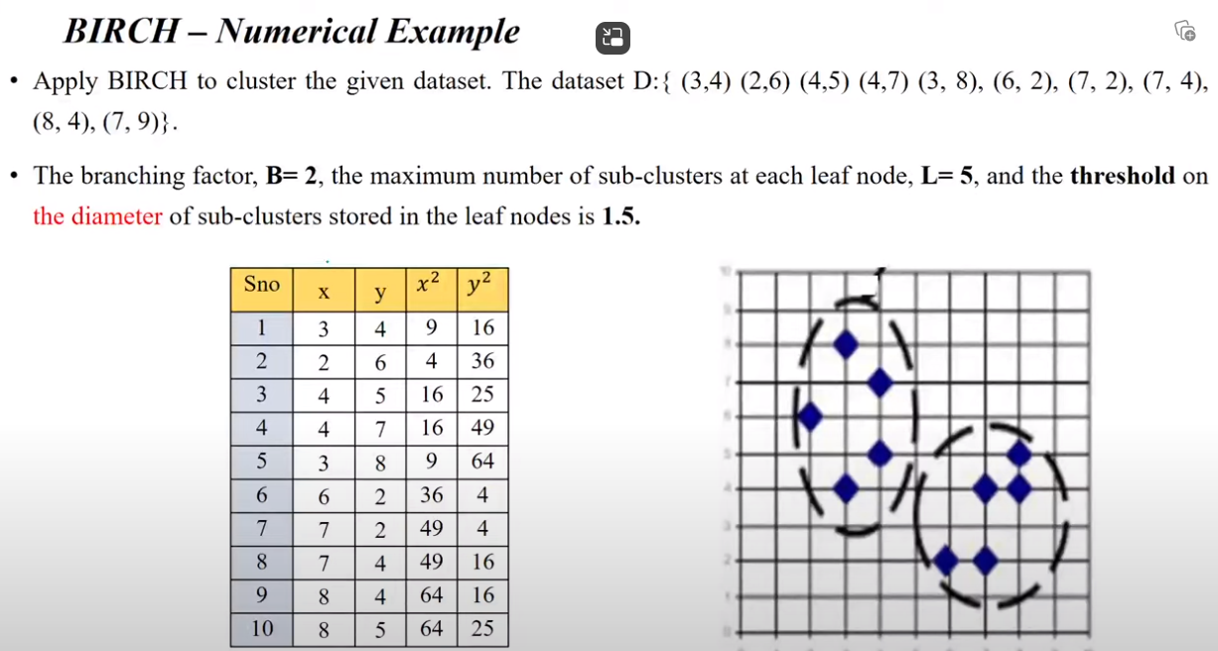

Slide 29
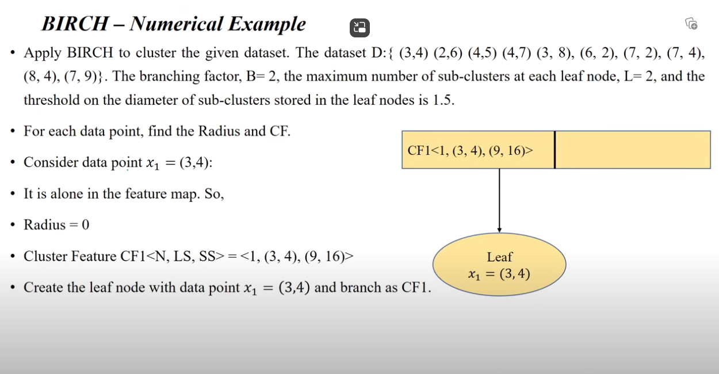

Slide 30
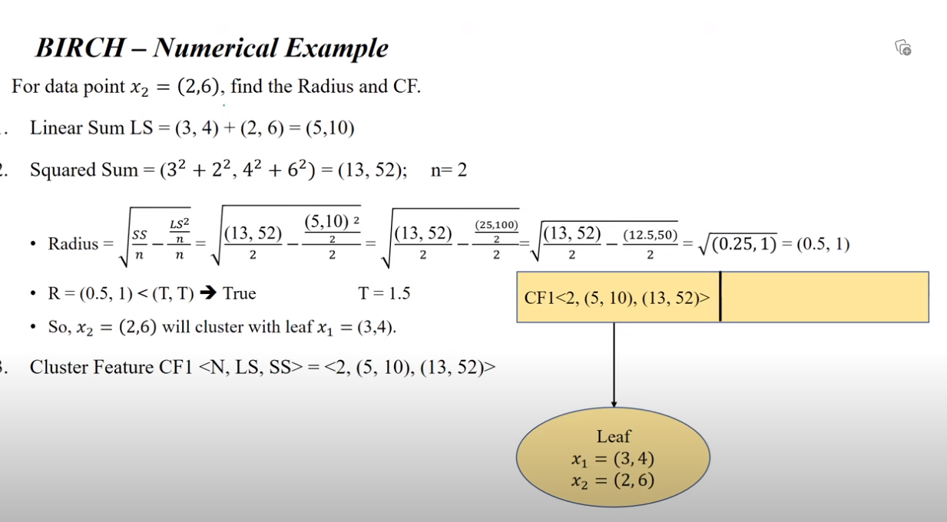

Slide 31
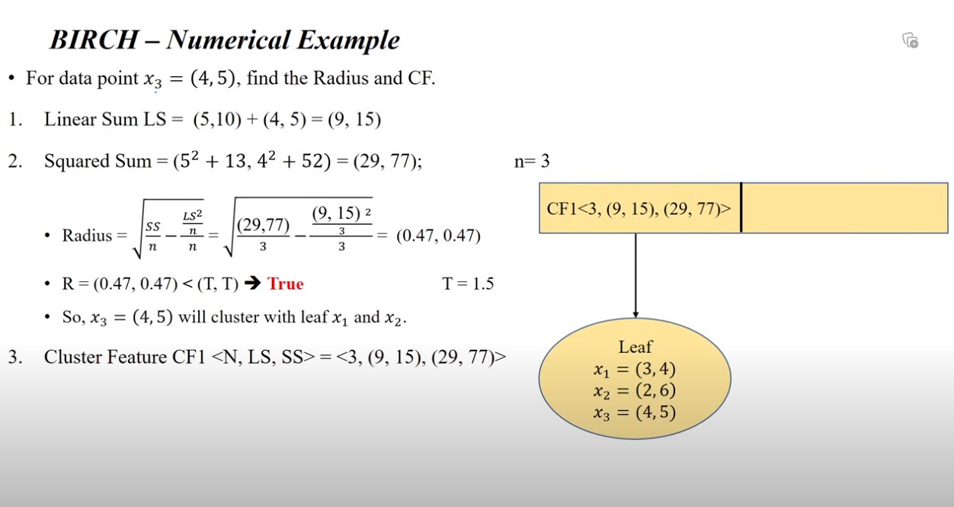

Slide 32
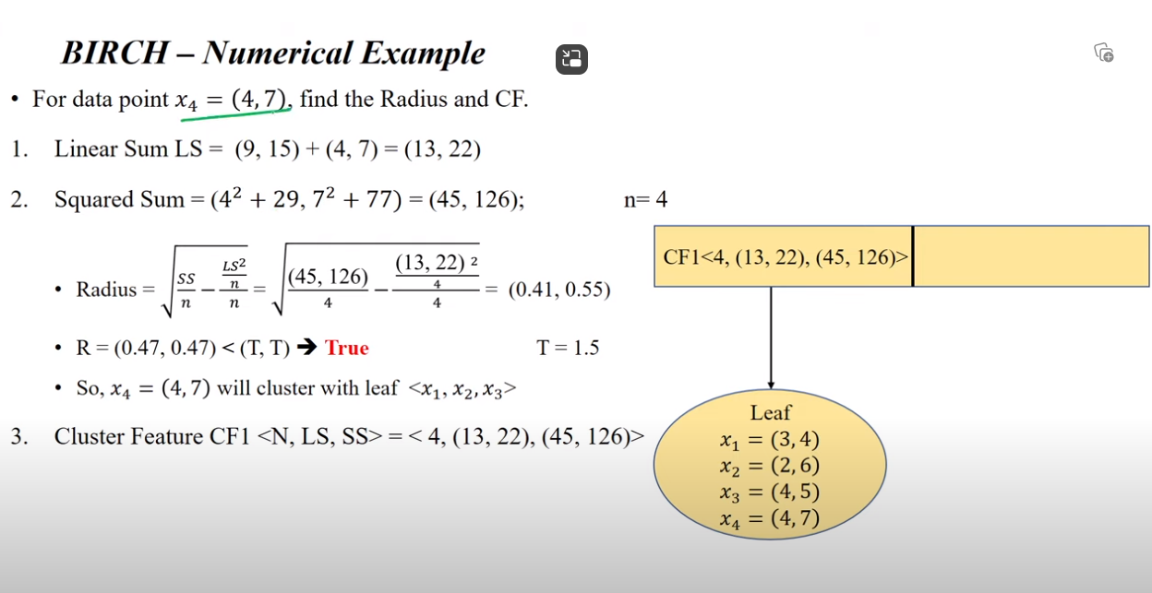

Slide 33
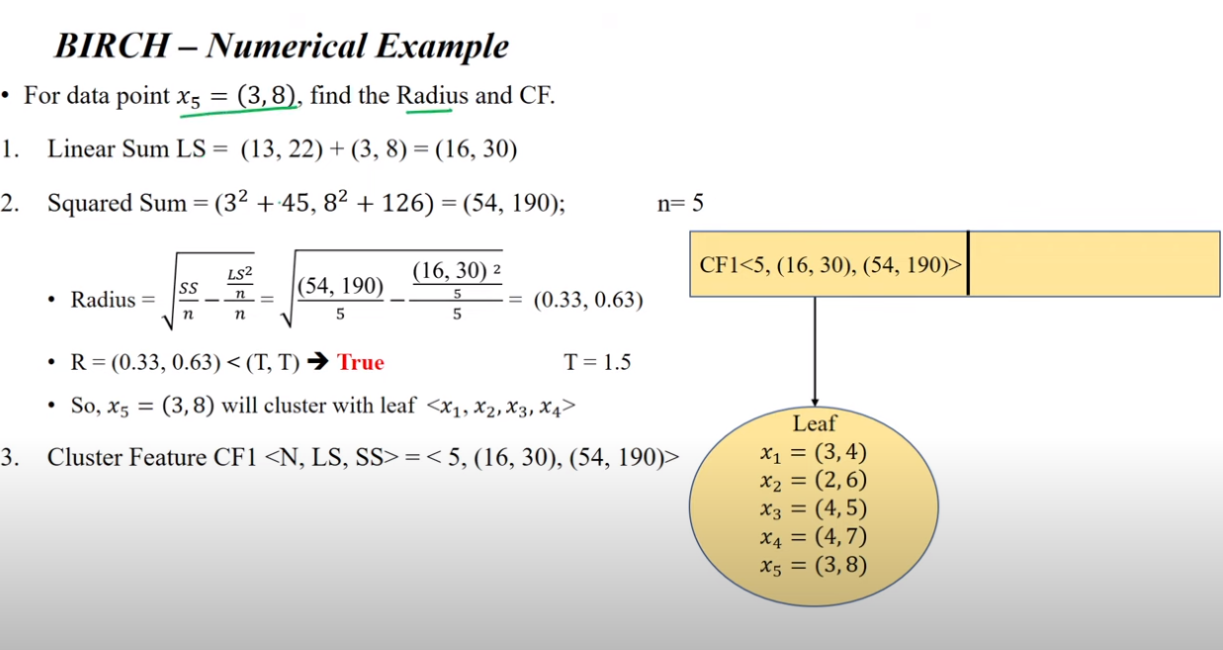

Slide 34
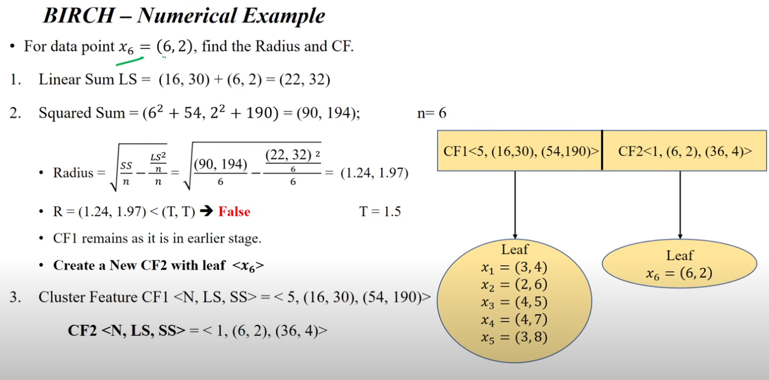

Slide 35
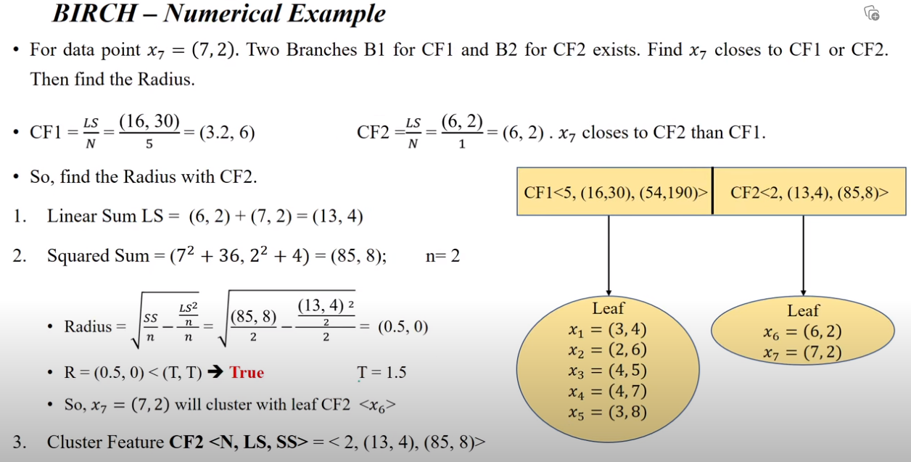

Slide 36
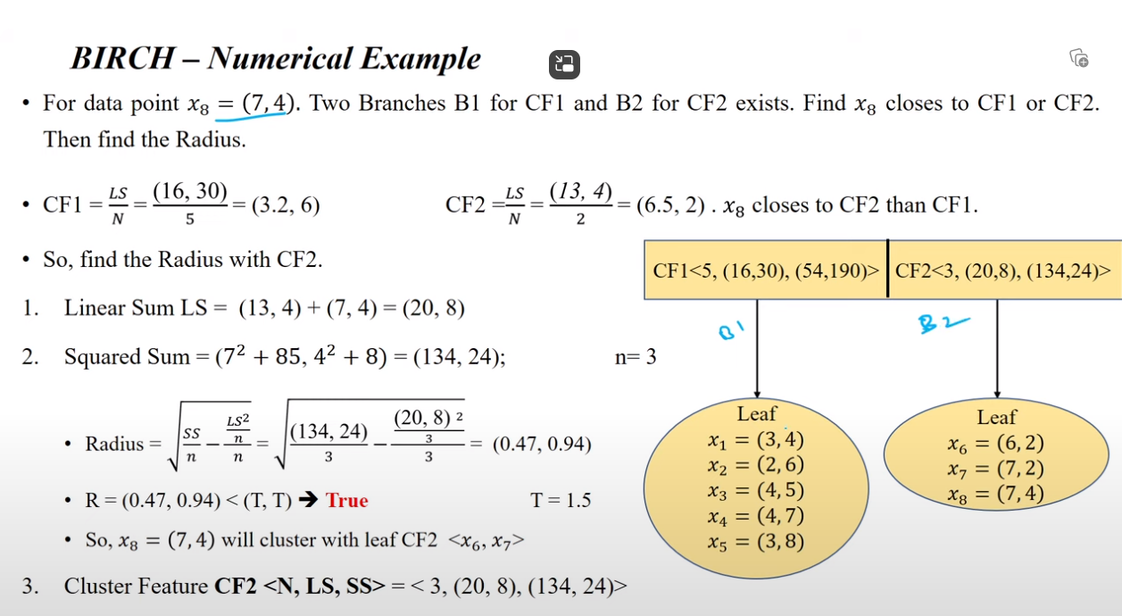

Slide 37
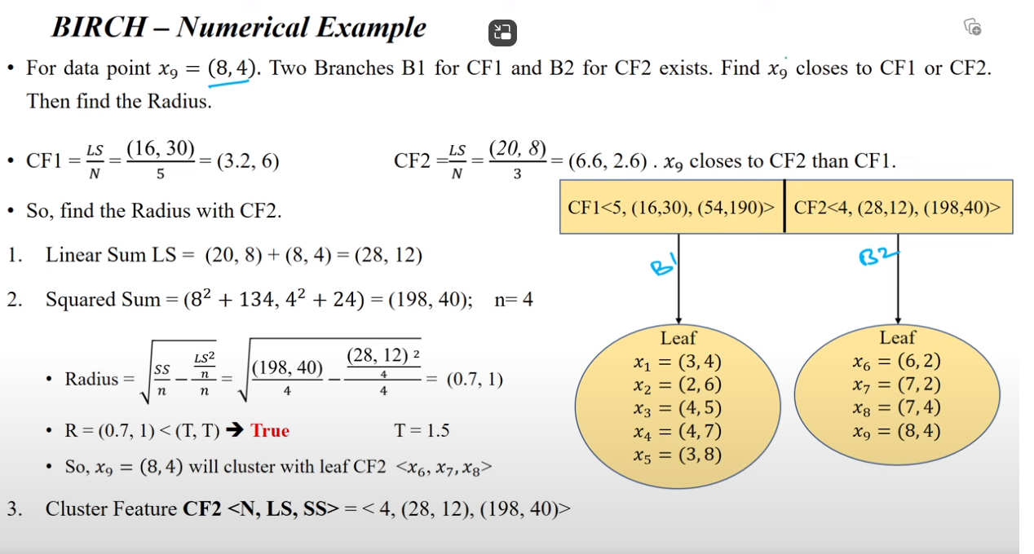

Slide 38
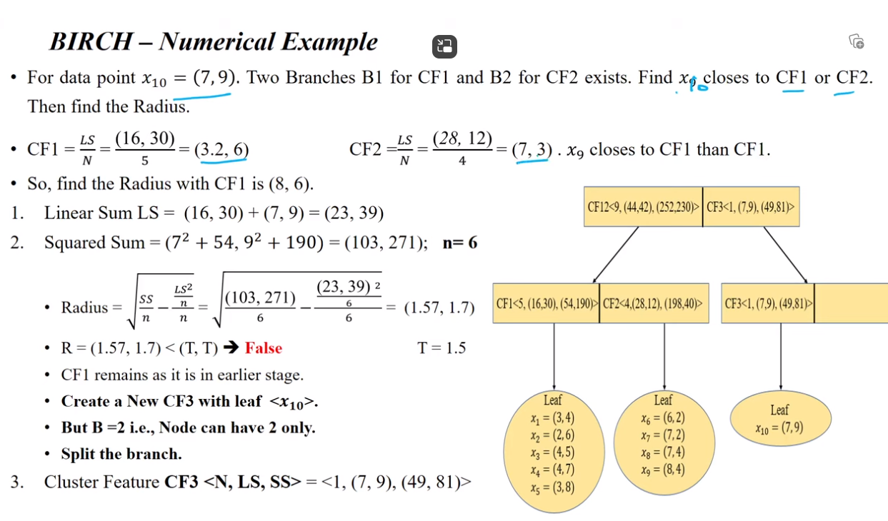
CF2

Slide 39
Reference
93 BIRCH Clustering - Numerical Example – YouTube
BIRCH Clustering 28-12-2020 (youtube.com)

